Slide 1
Write Less, Do More - The Power of Modern Java
Language features from Java 8 to 24

Slide 2



About Me
Sumanth K S
From Chikmagalur, Karnataka – the land of coffee & greenery
10+ years of experience in Java development
Currently working as a Technical Lead at DevOn, Bengaluru
Passionate about:
Exploring modern Java features
Writing clean, maintainable code
Sharing knowledge with the community

Slide 3
Why Learn New Java Features?
Old ways work… but not well in today’s industry
Modern features = cleaner, shorter, and safer code
Less boilerplate → more focus on solving problems
Helps you collaborate in teams and real-world projects
Increases your value as a software engineer in the job market
“Knowing new features isn’t just optional — it’s how you write professional, maintainable, and future-proof code.”

Slide 4
Clean CODE MINDSET
What is Clean Code?
Code that is readable, maintainable, and expressive
Follows minimalism: avoids unnecessary complexity or duplication
Emphasizes clarity of intent over cleverness
Enables easier testing, debugging, and onboarding

Slide 5
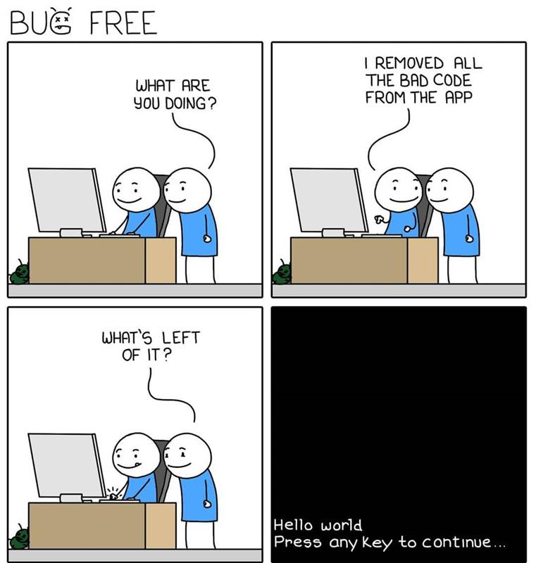

Slide 6
Lambda Expressions
What:
Introduced in Java 8
Enables functional programming by allowing functions as parameters
Syntax: (parameters) -> expression
Example: (a, b) -> a + b
Why:
Reduces boilerplate code for anonymous classes
Makes code more concise and readable
Improves collection processing with Streams

Slide 7
Functional Interfaces
What:
Introduced in Java 8
An interface with a single abstract method
Annotated with @FunctionalInterface (Optional)
Why:
Core foundation for Lambda expressions
Improves type safety when passing behaviour as parameters
Encourages functional programming patterns

Slide 8
Streams API
What:
Introduced in Java 8
Provides a declarative way to process collections (map, filter, reduce)
Supports parallel streams for performance
Why:
Simplifies collection operations without loops
Improves readability and reduces boilerplate
Enables functional-style data processing

Slide 9
Default & Static Methods in Interfaces
What:
Introduced in Java 8
Allows adding default implementations in interfaces using the default keyword
Supports static methods in interfaces as utility methods
Why:
Backward compatibility without breaking existing implementations
Reduces the need for abstract classes
Enables behaviour extension in interfaces

Slide 10
Optional Class
What:
Introduced in Java 8
A container object that may or may not contain a value
Methods: of(), empty(), orElse(), ifPresent()
Why:
Helps avoid NullPointerException
Encourages explicit handling of the absence of value
Improves code readability and safety

Slide 11
Method References
What:
Introduced in Java 8
Shorter syntax to call existing methods
Why:
Makes Lambda expressions more concise
Improves readability by reusing existing methods
Reduces redundancy in code

Slide 12
Factory Methods for Collections
What:
Introduced in Java 9
New static methods to create immutable collections
Methods: List.of(), Set.of(), Map.of()
Why:
Eliminates boilerplate code for initializing collections
Produces immutable collections (safe and thread-friendly)
Improves readability and performance

Slide 13
var – Local Variable Type Inference
What:
Introduced in Java 10 (standard)
Allows using var to declare local variables with inferred types
Syntax: var name = "John"; → compiler infers String
Why:
Reduces boilerplate for obvious types
Improves readability when the type is clear from context

Slide 14
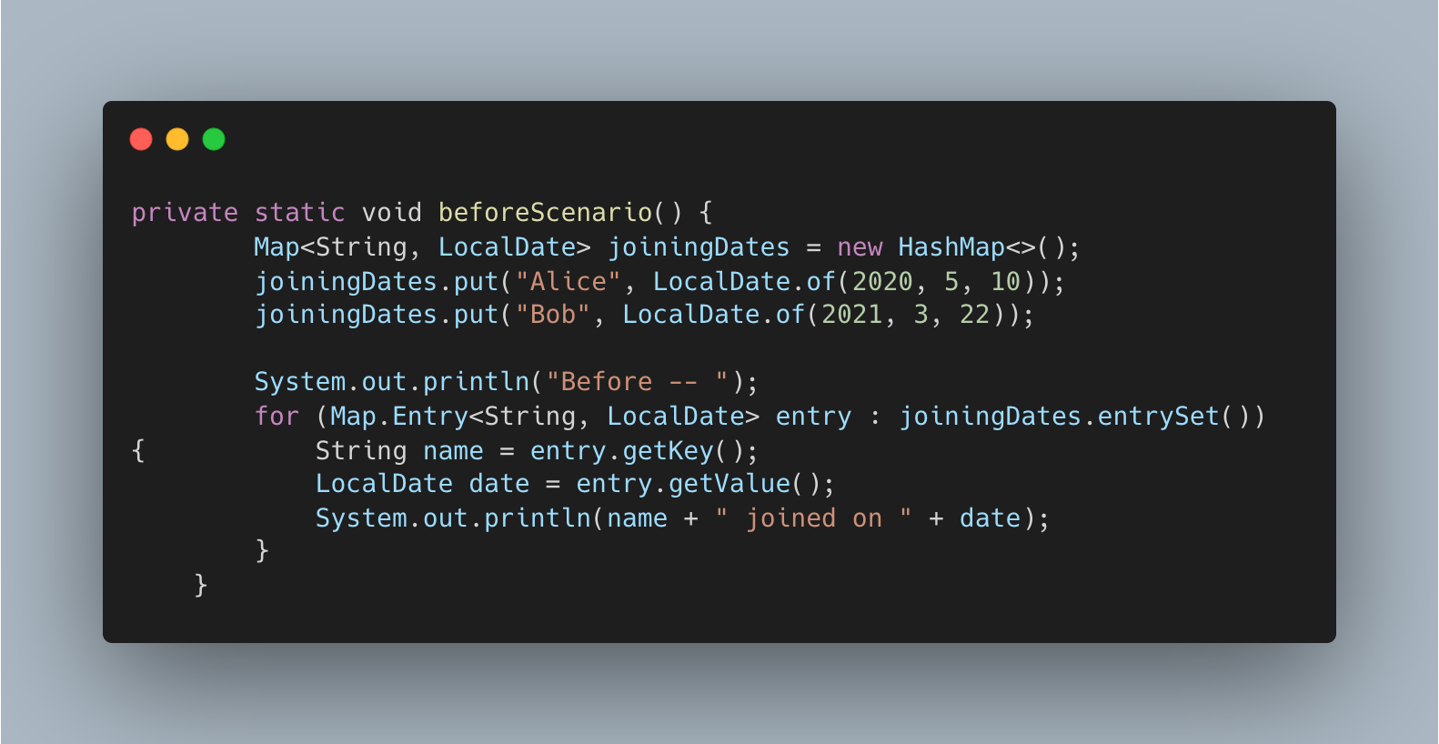

Slide 15
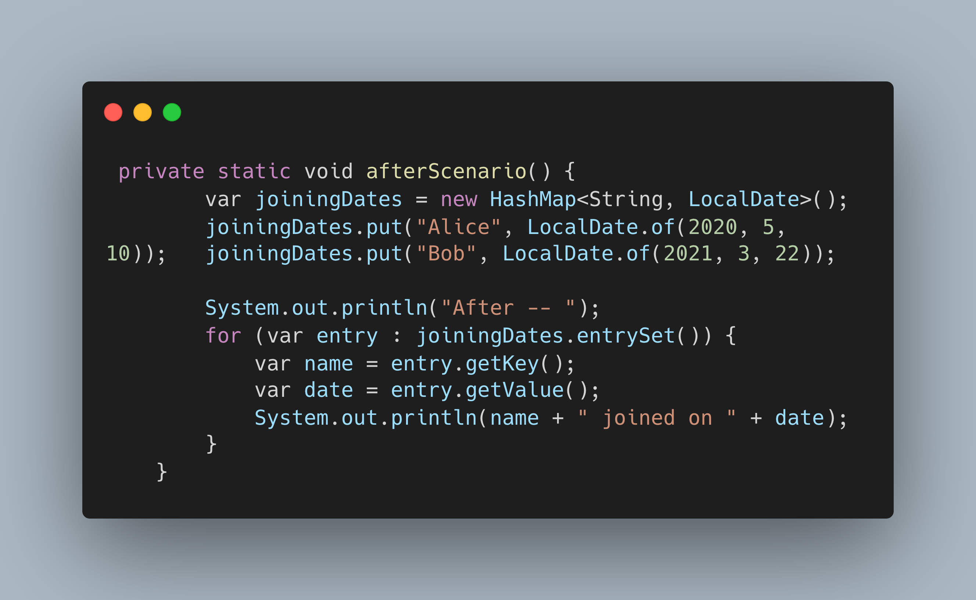

Slide 16
New String methods
What:
Introduced in Java 11 (standard)
Added methods: isBlank(), lines(), strip(), stripLeading(), stripTrailing(), repeat()
Why:
Simplifies common string operations without external libraries
Unicode-aware trimming (replaces trim())
Enables cleaner code with fewer helper methods

Slide 17
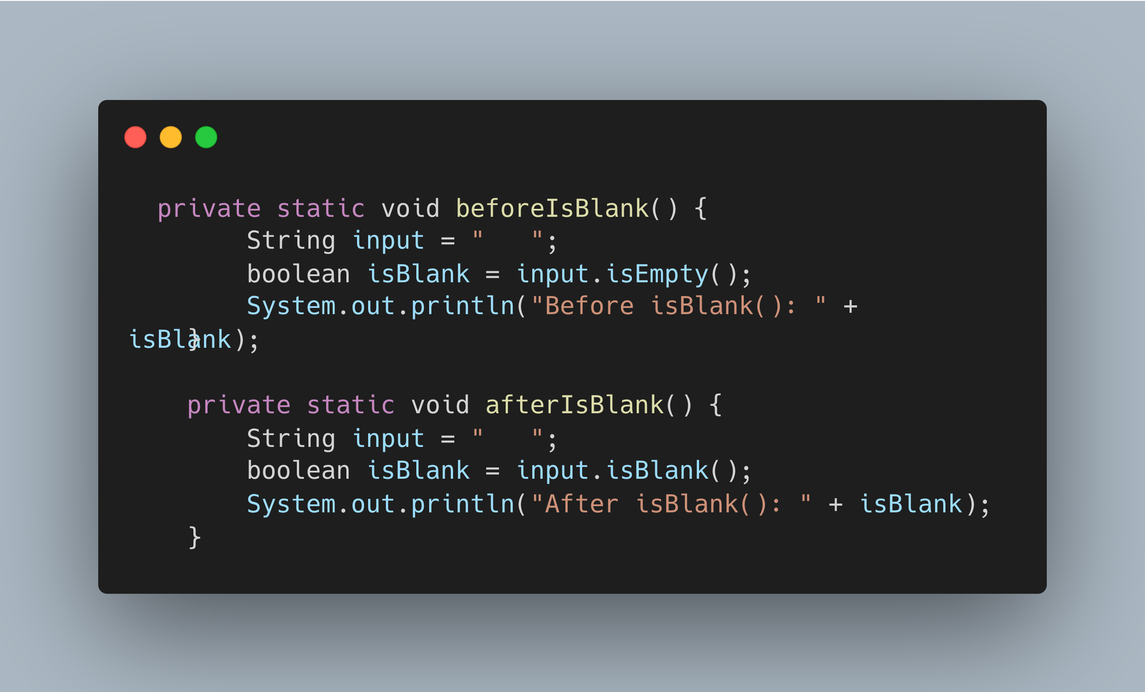

Slide 18
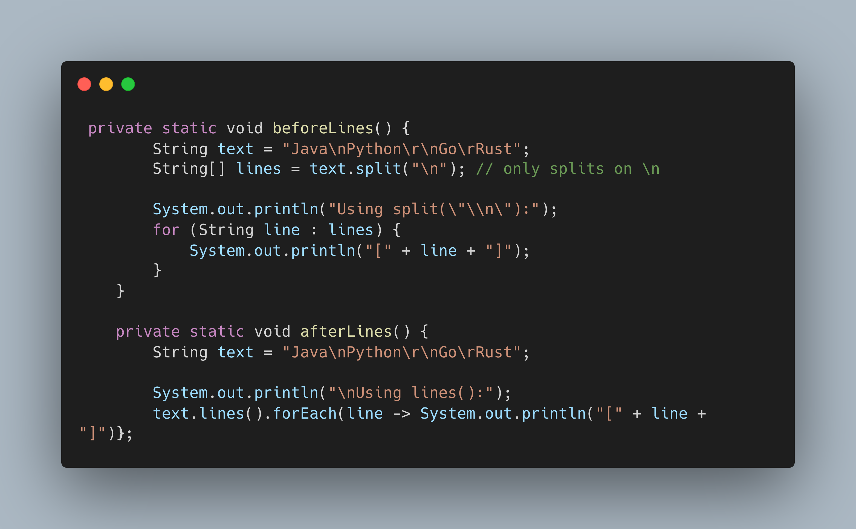

Slide 19
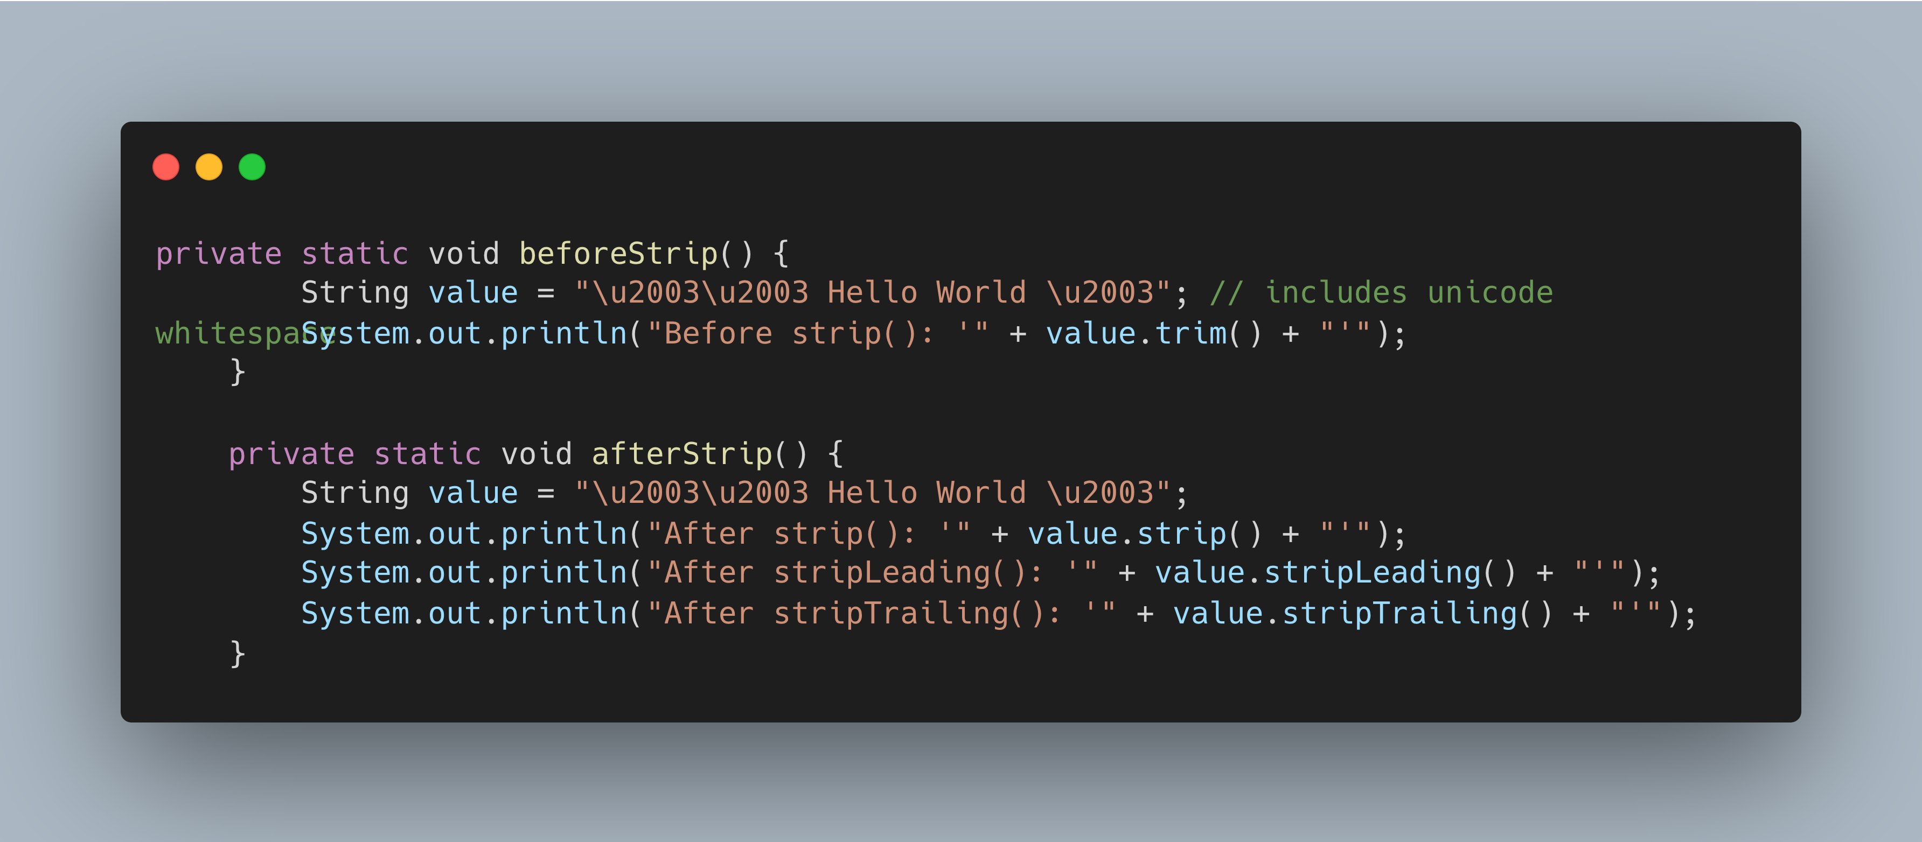

Slide 20
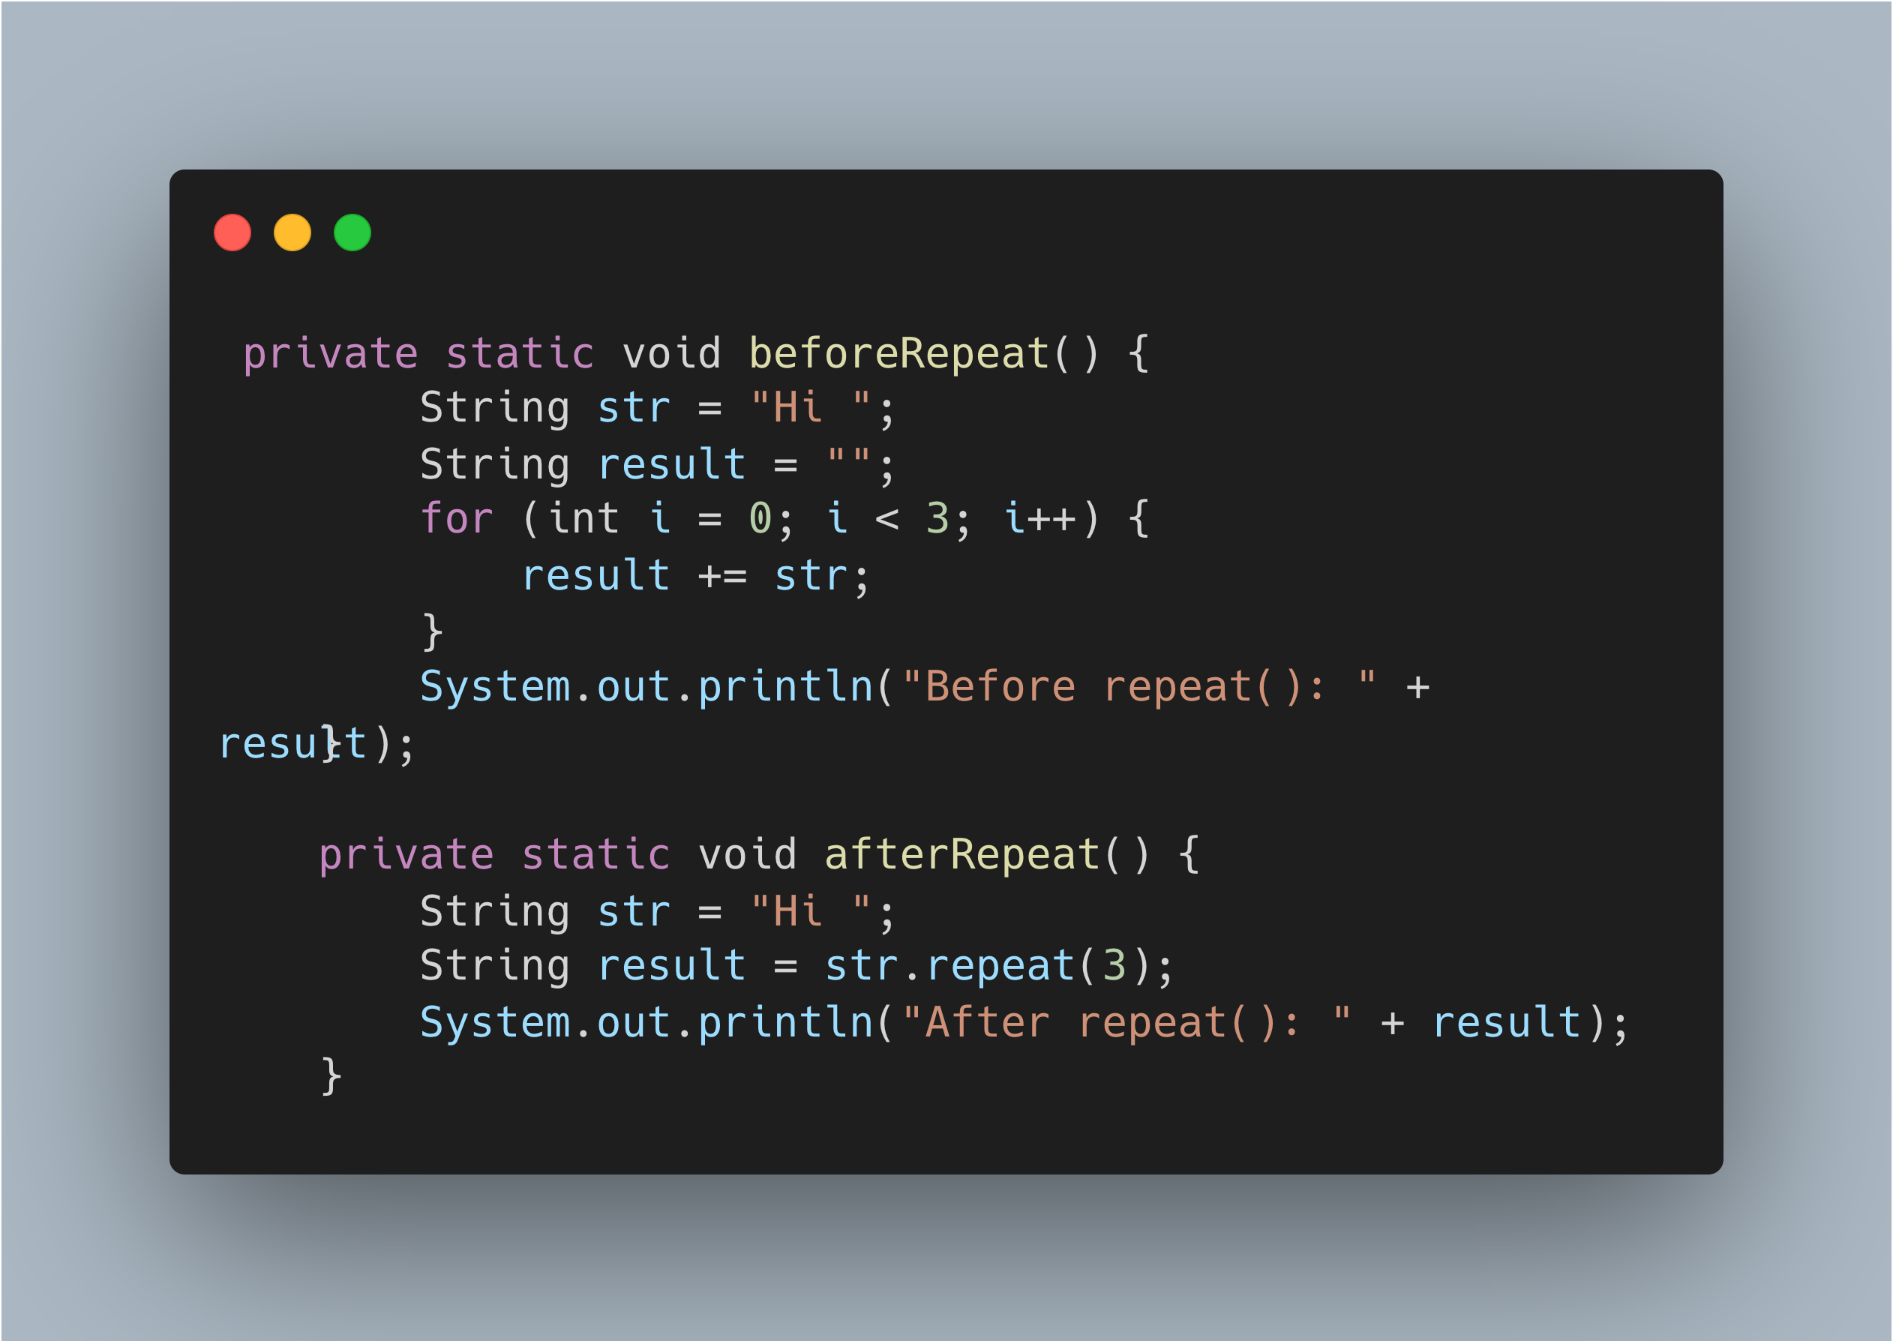

Slide 21
Compact Number Formatting
What:
Introduced in Java 12 (standard)
getCompactNumberInstance()
Formats numbers in a shortened, human-readable form (e.g., 1K, 2M)
Why:
Eliminates the need for custom number shortening logic
Enhances readability in UI and reports

Slide 22
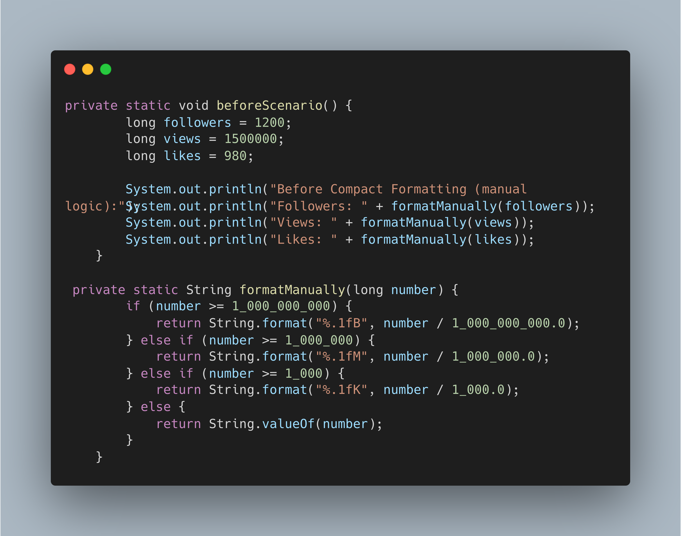

Slide 23
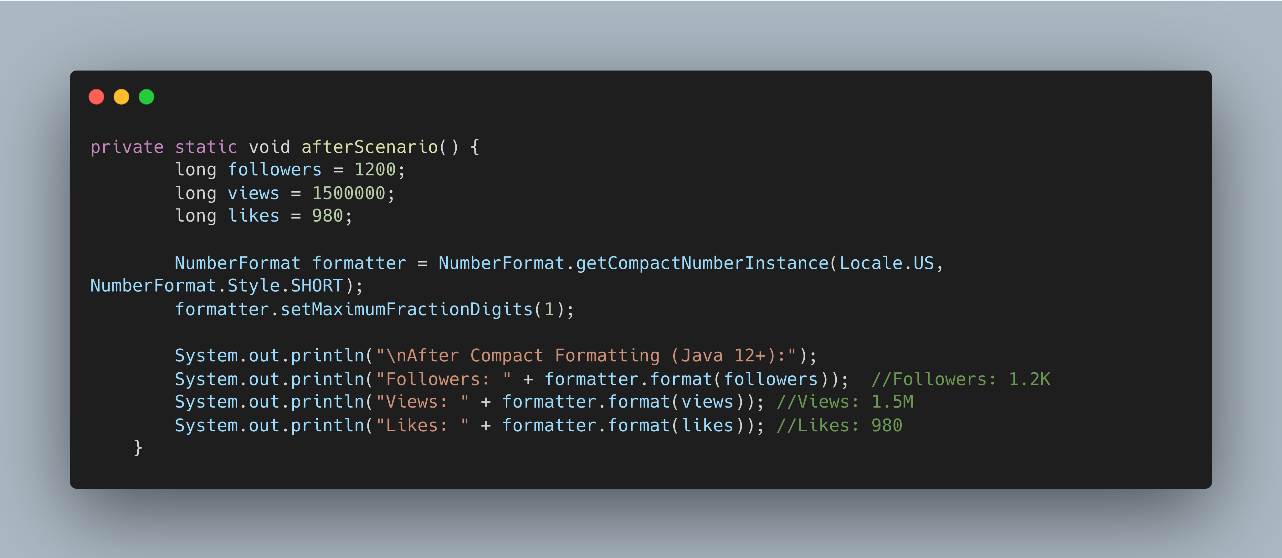

Slide 24
Enhanced switch Expressions
What:
Introduced as standard in Java 14
Allows a switch to be used as an expression that returns a value
Supports arrow syntax (->) and yield
Why:
Eliminates the need for break and fall-through cases
Great for returning values directly from switch, improving readability and maintainability

Slide 25
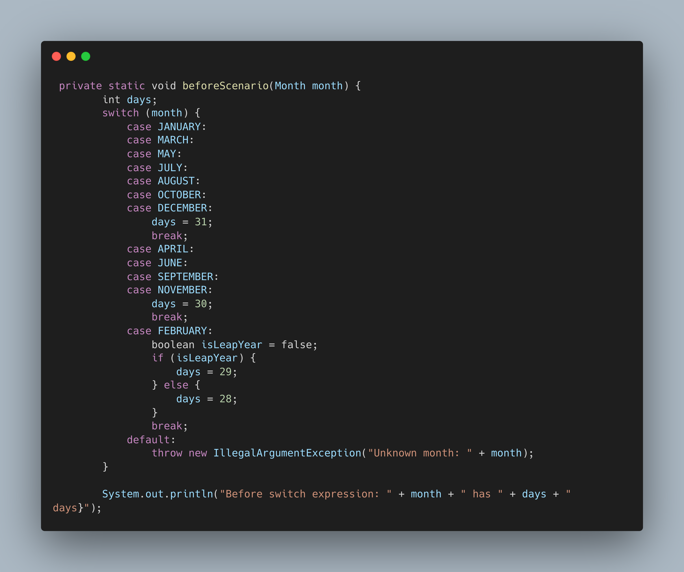

Slide 26
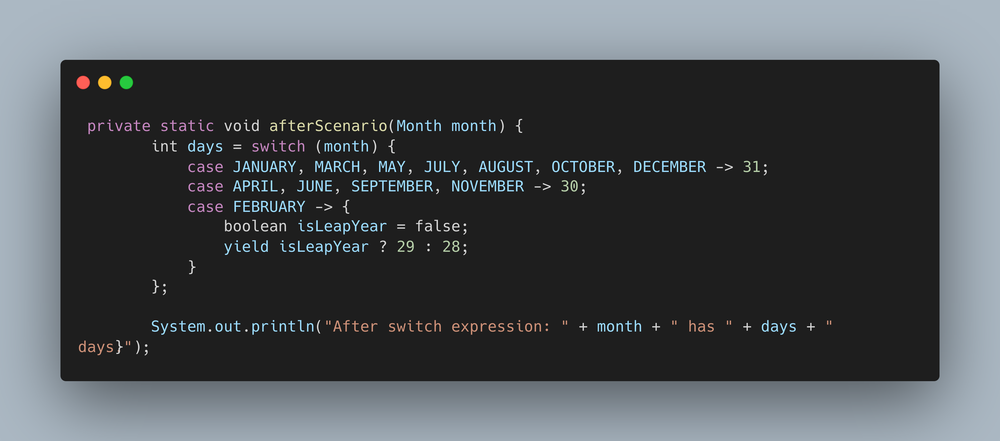

Slide 27
Text blocks
What:
Introduced in Java 15 (standard)
Allows writing multi-line strings using the """ syntax
Why:
Improves readability of JSON, SQL, XML, and HTML

Slide 28
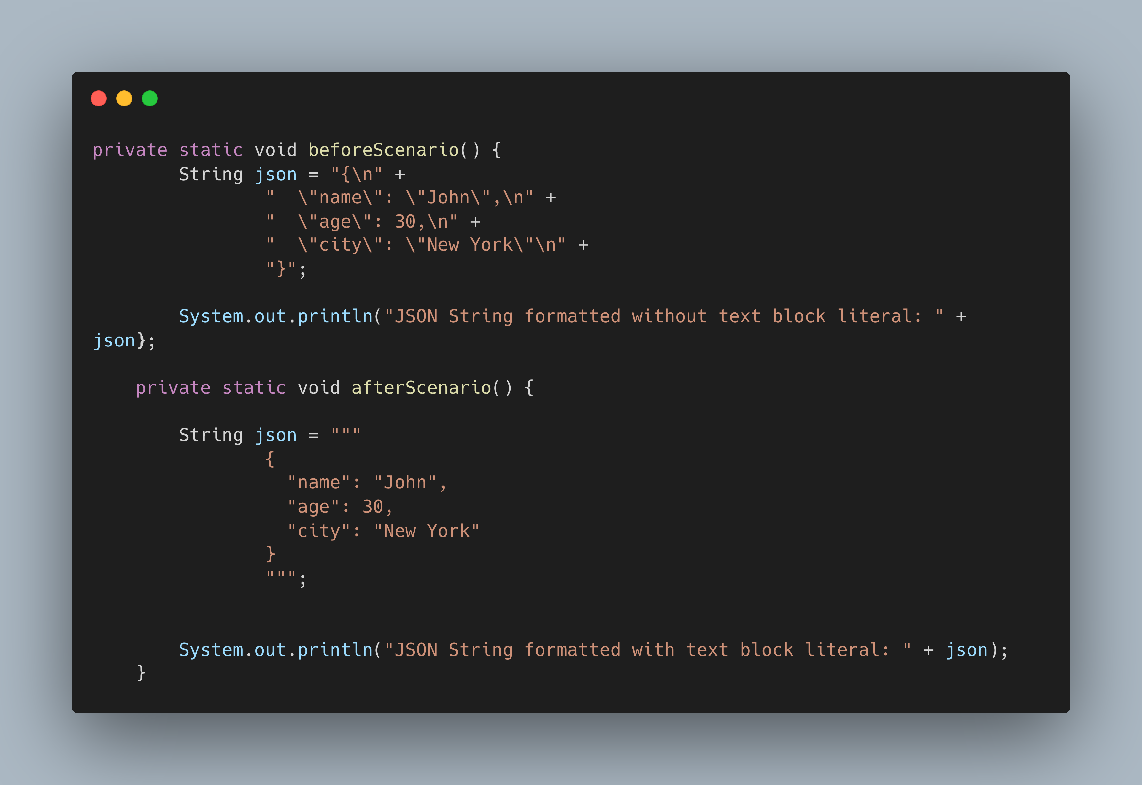

Slide 29
Records
What:
Introduced in Java 16 (standard)
Compact syntax for declaring immutable data carriers
Auto-generates: Constructor, Getters, equals(), hashCode(), toString()
Why:
Eliminates boilerplate code in POJOs
Enhances readability and intent clarity
Ideal for DTOs, event models, and value objects

Slide 30
Pattern Matching for instanceof
What:
Introduced in Java 16 (standard)
Allows type check and cast in a single step
Simplifies the usage of instanceof with pattern binding
Why:
Removes redundant casting
Improves code clarity and safety
Enables more concise and readable conditional logic

Slide 31
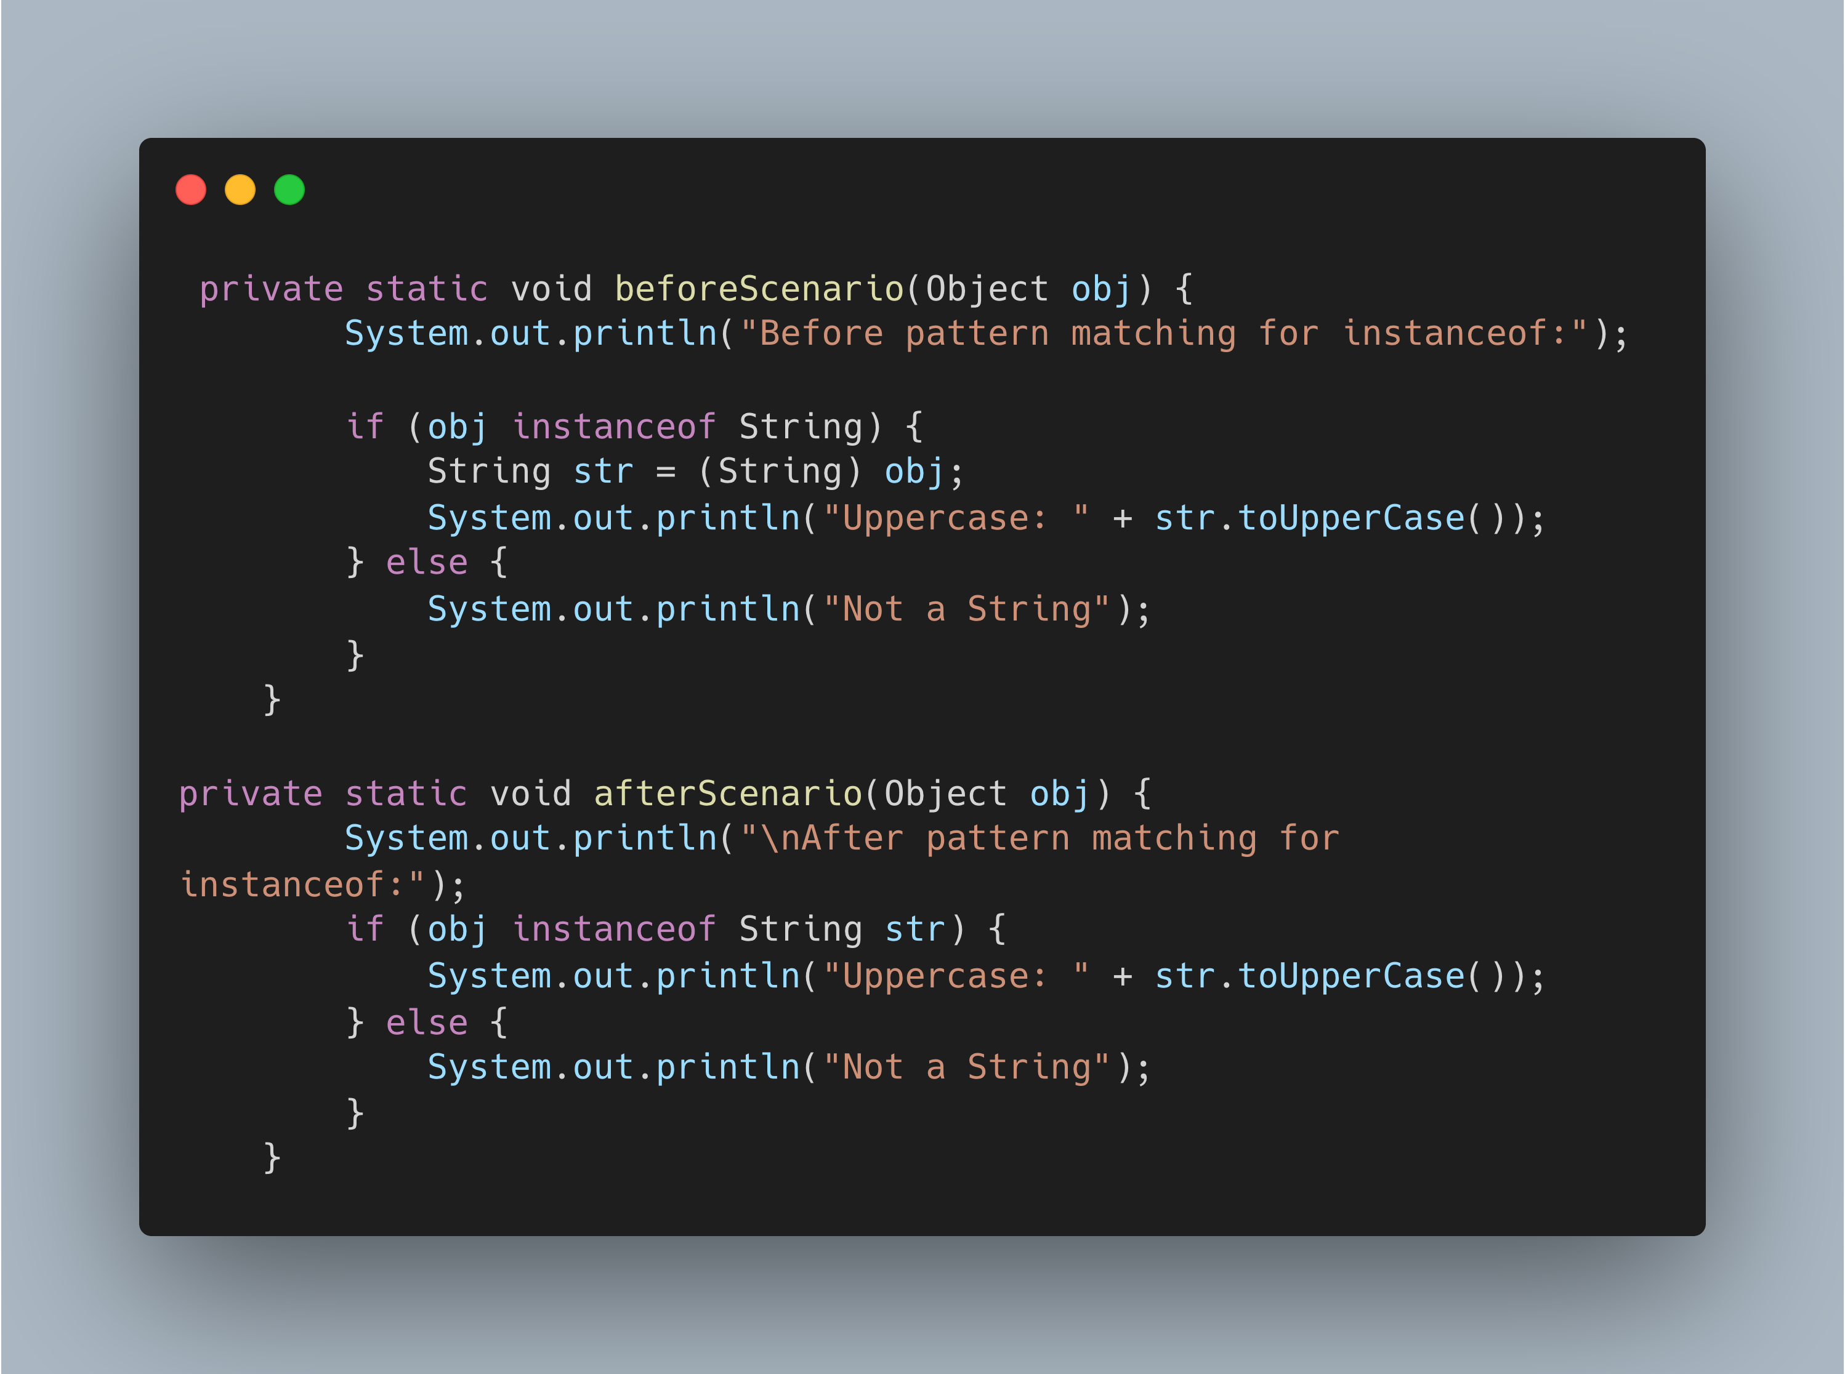

Slide 32
Sealed Types
What:
Introduced in Java 17 (standard)
Allow a class or interface to restrict which other classes may extend or implement it
Why:
Provide explicit control over type hierarchies
Improve code safety and intent clarity

Slide 33
Pattern Matching for switch
What:
Standardized in Java 21
Enhances the switch to support type patterns and guarded patterns
Works with objects, records(Stadardized in Java 22), and sealed types
Why:
Makes the switch more powerful and expressive
Eliminates the need for multiple if-else instanceof blocks

Slide 34
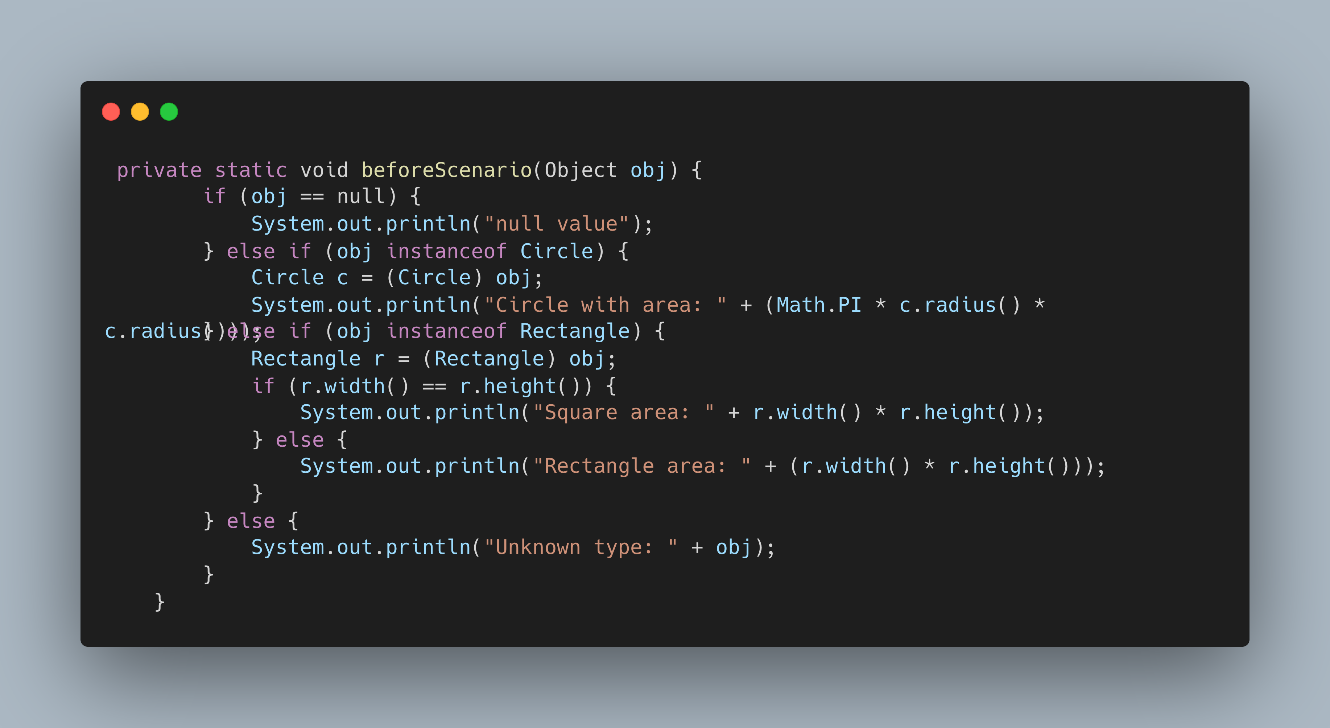

Slide 35
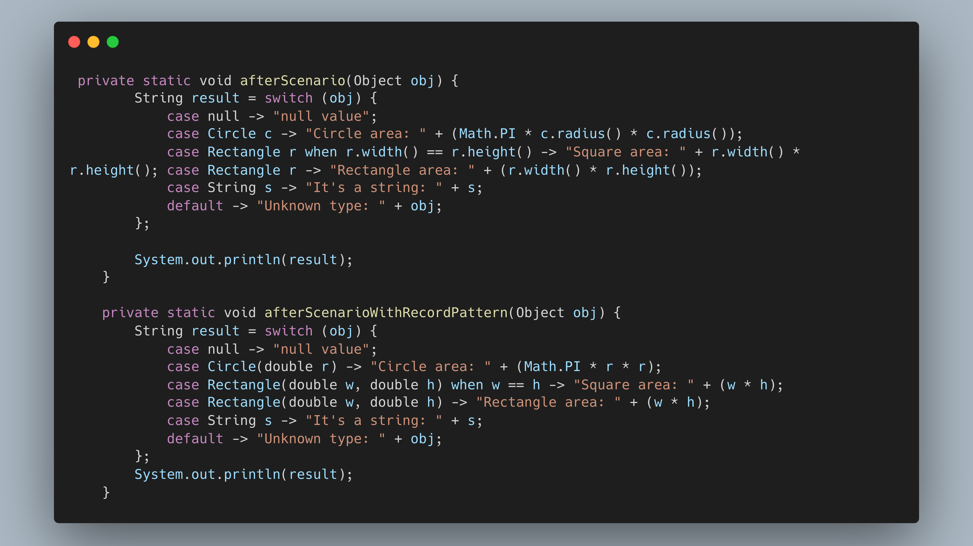

Slide 36
Stream Gatherers
What:
Introduced in Java 24 (standard)
Allows creation of custom intermediate operations
(e.g., windowing, grouping, filtering with memory) Why:
Expands the flexibility of Stream pipelines
Enables stateful, composable, and reusable stream operations
Promotes cleaner code for complex stream transformations

Slide 37
Thank you

Slide 38

GitHUB Repo

Slide 39

Linkedin profile

Slide 40
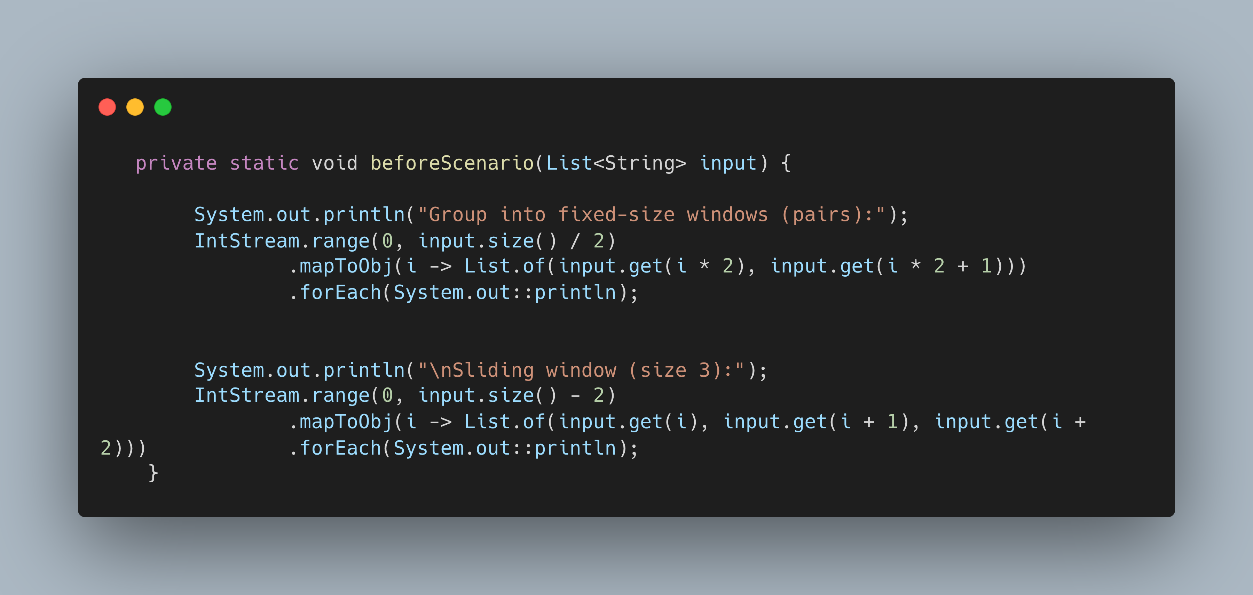

Slide 41
